Slide 1
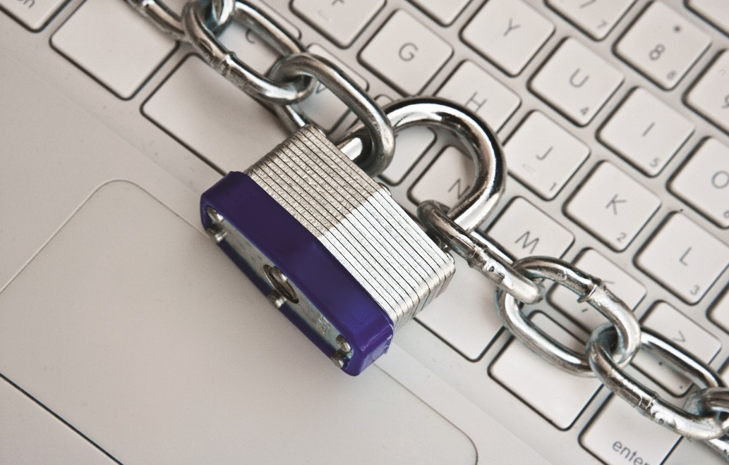
IT Essentials (CompTIA A+) Ch. 28
Securing Computers

Slide 2
Overview
Analyzing Threats
Access Control
Threats and Countermeasures
Detection, Prevention, and Recovery
Notes:
2
Instructor Tip
When gaining attention and establishing common ground, ask questions of the class such as, “How many of you have ever had a computer infected by a virus or spyware?” or “How many of you have ever lost data?”
For a WIIFM statement, say to the class, “Joe’s at work, and Sally calls him up on the phone saying she’s from the IT department and needs to upgrade his computer with several key applications. Joe’s computer will be down for several hours. “Oh no,” he says, realizing he needs to get some work done and needs the computer. “Isn’t there another way?” Joe asks. Sally says, ‘Well, don’t tell anyone I’m doing this, but I can do it remotely while you’re still using the computer. The thing is, though, I’ll need your user name and password.” Does Joe give the password to Sally? This is a classic example of social engineering; Sally doesn’t really work in the IT department but instead is simply randomly calling people trying to get their password. We’ll learn about this and other security threats in this chapter.”

Slide 3
Notes:
3
Instructor Tip
When gaining attention and establishing common ground, ask questions of the class such as, “How many of you have ever had a computer infected by a virus or spyware?” or “How many of you have ever lost data?”
For a WIIFM statement, say to the class, “Joe’s at work, and Sally calls him up on the phone saying she’s from the IT department and needs to upgrade his computer with several key applications. Joe’s computer will be down for several hours. “Oh no,” he says, realizing he needs to get some work done and needs the computer. “Isn’t there another way?” Joe asks. Sally says, ‘Well, don’t tell anyone I’m doing this, but I can do it remotely while you’re still using the computer. The thing is, though, I’ll need your user name and password.” Does Joe give the password to Sally? This is a classic example of social engineering; Sally doesn’t really work in the IT department but instead is simply randomly calling people trying to get their password. We’ll learn about this and other security threats in this chapter.”

Slide 4
Analyzing Threats
Threats to your data come from physical accidents and malicious people.
Users getting access to folders they shouldn’t see
Viruses striking and deleting folders
Dead hard drives
Scratched optical disks

Slide 5
Analyzing Threats
Unauthorized Access can arise from many sources
Curiosity and poor user account management
Dumpster diving
Searching through the trash looking for information
Shoulder surfing
Observing someone’s screen or keyboard to get information

Slide 6
Analyzing Threats
Social engineering is a process of using or manipulating people inside the organization to gain access.
Classic types of social engineering attacks:
Infiltration
Telephone scams (Vishing)
Phishing
Notes:
6

Slide 7
Analyzing Threats
Infiltration
Hackers enter a building in the guise of legitimacy.
After gaining entry, hackers snoop around desks, talk to people, and gather pieces of information.
Following someone through a door is tailgating.
A mantrap design can combat tailgating.
Outer door must be closed before inner door is opened.
An entry control roster is managed by a guard.
Notes:
7

Slide 8
Analyzing Threats
Telephone scams
Most common type of social engineering attack
Simply asking for information
Calling help desk impersonating someone and getting their password reset
Phishing
Attempts to obtain usernames and passwords
Typically performed through e-mail
Attacker poses as a legitimate company and asks for your login credentials.
Spear phishing: a targeted attack
Notes:
8

Slide 9
Analyzing Threats
Data destruction is more than the intentional or unintentional erasing or corrupting data.
Can originate from authorized or unauthorized users
Can originate from untrained users
Users may be uninformed about extent to which they are authorized to make changes.
Notes:
9

Slide 10
Analyzing Threats
Administrator, supervisor, or root user accounts
Have full control over the computer
Can do vastly more damage when compromised
User requiring administrative access
Use strong passwords and practice good physical security
Follow the Principle of Least Privilege.
Administrator, Power User, Standard User, Guest.

Slide 11
Analyzing Threats
Computers can and will fail.
Failures happen at inopportune times.
Hard drives crash.
Power fails.
Create redundancy in areas prone to failure.
Maintain backups.
Implement RAID

Slide 12
Analyzing Threats
Protect your systems physically.
The best network software security measures are useless if systems not physically protected.
Malware presents a threat.
Networks are efficient vehicles for transmitting viruses.
In addition to Internet attacks, users’ optical disks and USB drives are sources of malicious software attacks.

Slide 13
Analyzing Threats
Environmental Threats
Power
Surge suppressors and uninterruptible power supplies (UPSs) are important protective measures.
Environmental controls
Protect servers and workstations from the impacts of excessive heat, dust, and humidity.
Environmental controls include air conditioning, proper ventilation, air filtration, and temperature and humidity monitoring.

Slide 14
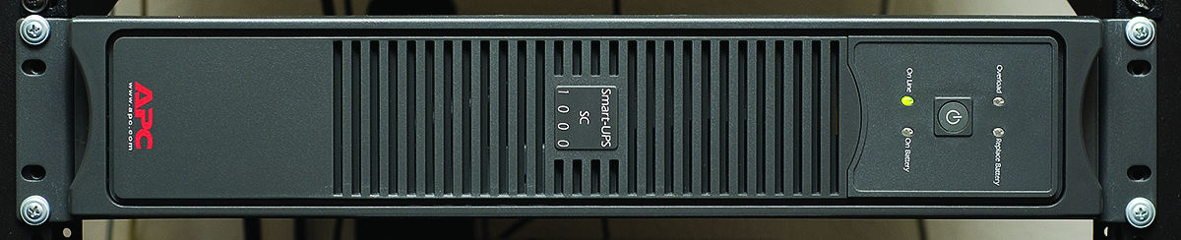
Analyzing Threats
Figure 28.1 UPS on rack

Slide 15
Analyzing Threats
Dirty air
Dust and debris can harm electronic components.
Air conditioning systems in buildings do a good job of removing airborne dirt.
All electronic components get dirty over time.
Use either compressed air or a nonstatic vacuum to clean components.
Another option is to enclose a system in a dust shield.
Dust shields come complete with their own filters.

Slide 16
Analyzing Threats
Temperature and humidity are important considerations.
Most computers are designed to operate around 22°C (72°F) with relative humidity in the 30 to 40 percent range.
Colder and dryer air is better for computers.
Ensure air ducts are free from obstructions.
Prevent equipment from being closed off from proper ventilation.

Slide 17
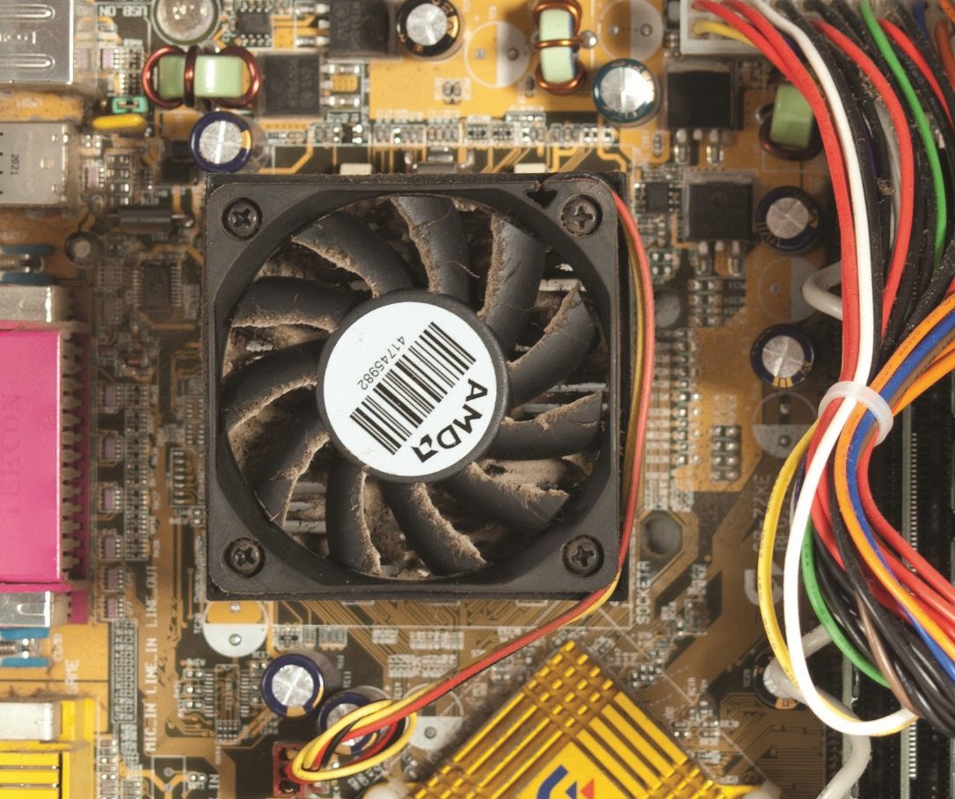
Analyzing Threats
Figure 28.2 Dirty fan

Slide 18
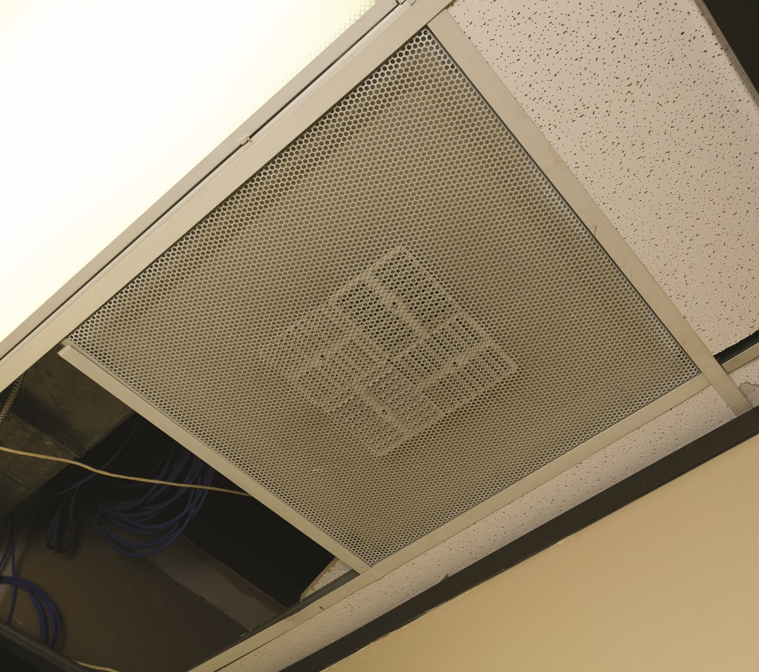
Analyzing Threats
Figure 28.3 Air-conditioning vent in a small server closet

Slide 19
Analyzing Threats
Toxic materials
Every office has chemicals that can be stored, spilled, or dumped.
If something unfamiliar spills, refer to the Material Safety Data Sheet (MSDS) for proper handling and disposal procedures.
Always comply with local government regulations when dealing with chemicals.
Including batteries and metals on circuit boards
Notes:
Most U.S. cities have one or more environmental services centers that you can use to recycle electronic components. For your city, try a Google (or other search engine) search on the term “environmental services” and you’ll almost certainly find a convenient place for e-waste disposal.

Slide 20

Analyzing Threats
Notes:
Most U.S. cities have one or more environmental services centers that you can use to recycle electronic components. For your city, try a Google (or other search engine) search on the term “environmental services” and you’ll almost certainly find a convenient place for e-waste disposal.

Slide 21
Access Control
Security requires strategic and tactical goals
Understand the big picture and available technologies for security.
Know the specific tools for securing resources on the network.
Concept and technology areas
Access control
Data classification and compliance
Reporting

Slide 22
Access Control
Access control—the process of controlling access to data, programs, and other computing resources—is composed of four interlinked areas:
Physical security
Authentication
Users and groups
Security policies

Slide 23
Access Control
Secure physical area and lock down systems
Lock the door to your workspace.
Do not leave a computer while logged in.
ID badges can be used to control building access and store authentication tools such as radio frequency identification (RFID) or smart cards.
Identify poor security practices (writing down passwords or leaving sensitive documents in sight).
Use privacy filters to guard against shoulder surfing.

Slide 24
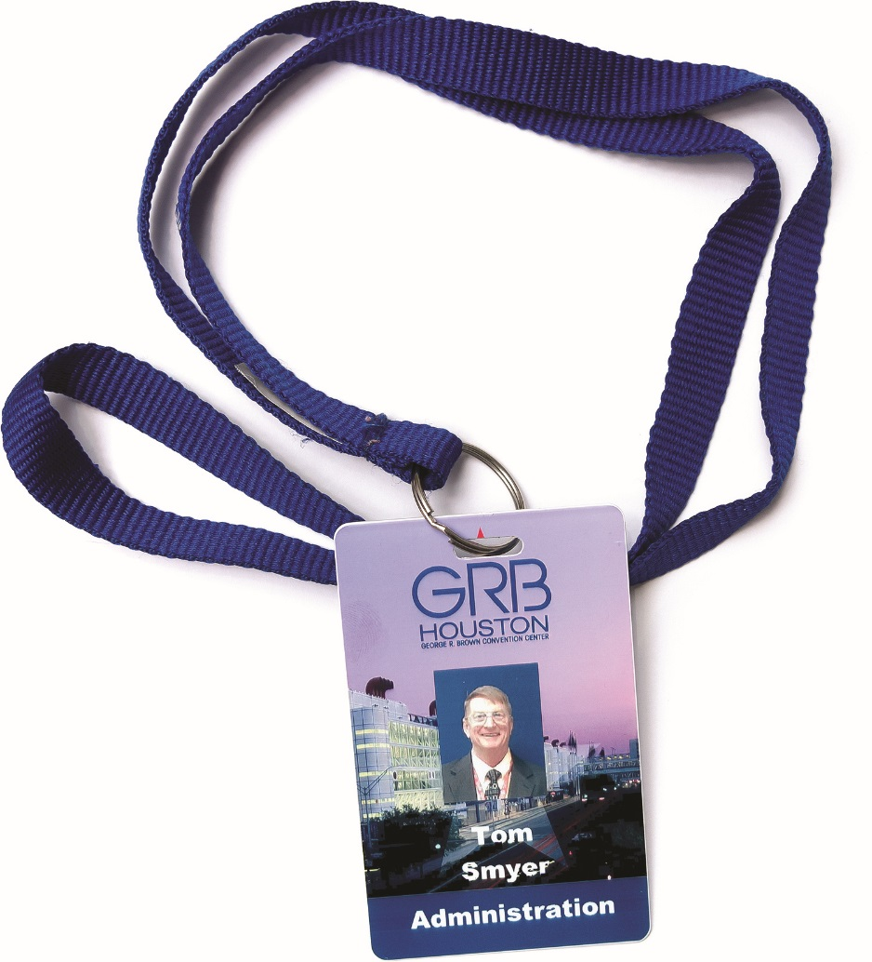
Access Control
Figure 28.4 Typical employee badge/smart card

Slide 25
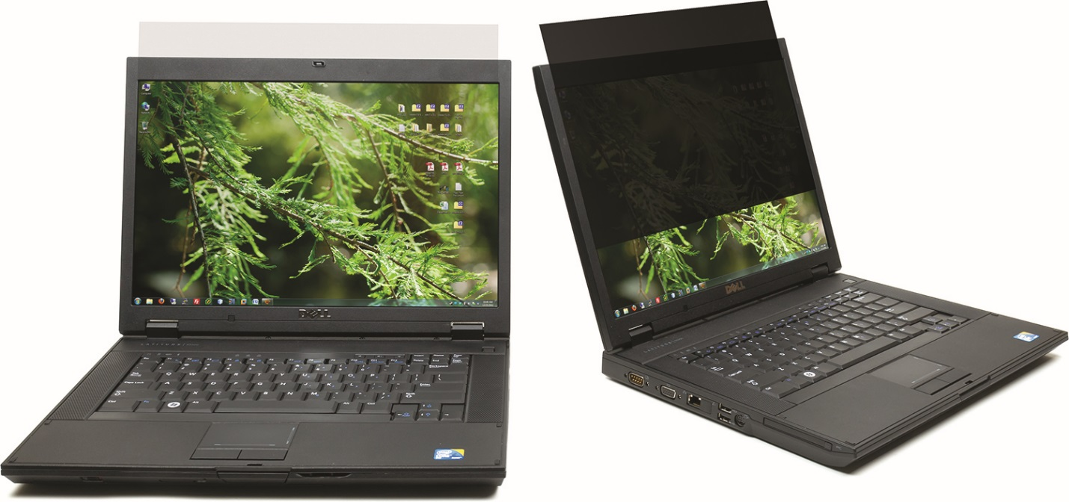
Access Control
Figure 28.5 Privacy filter

Slide 26
Access Control
Authentication
Many organizations use two-factor authentication.
Software authentication
Users must have proper passwords.
Hardware authentication
Smart cards
Biometric devices
Security tokens
RSA tokens

Slide 27
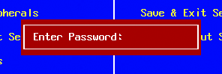
Access Control
Figure 28.6 BOIS/UEFI access password request

Slide 28
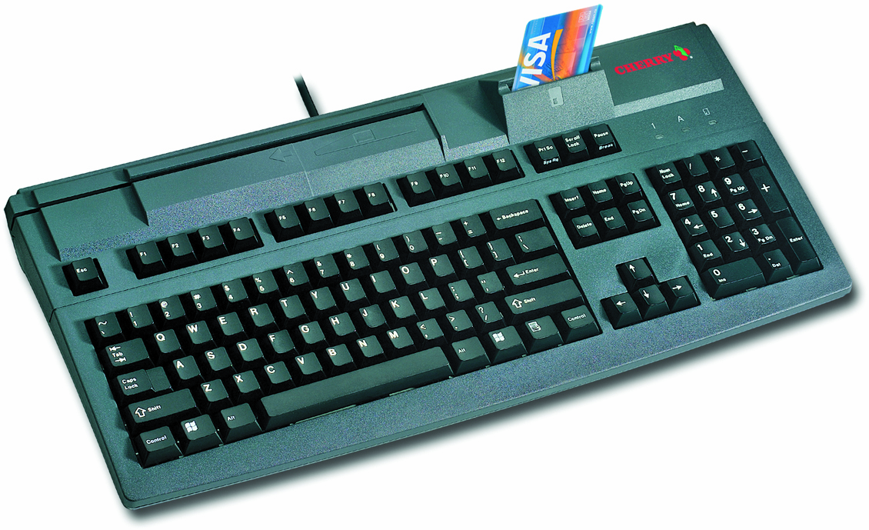
Access Control
Figure 28.7 Keyboard-mounted smart card reader being used for a commercial application (photo courtesy of Cherry Corp.)

Slide 29
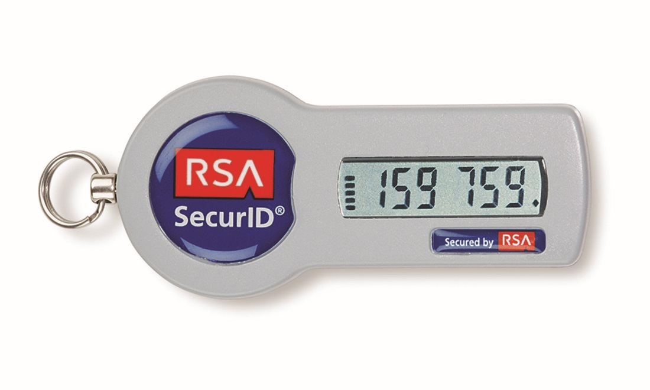
Access Control
Figure 28.8 RSA key fob (photo courtesy of EMC Corp.)

Slide 30
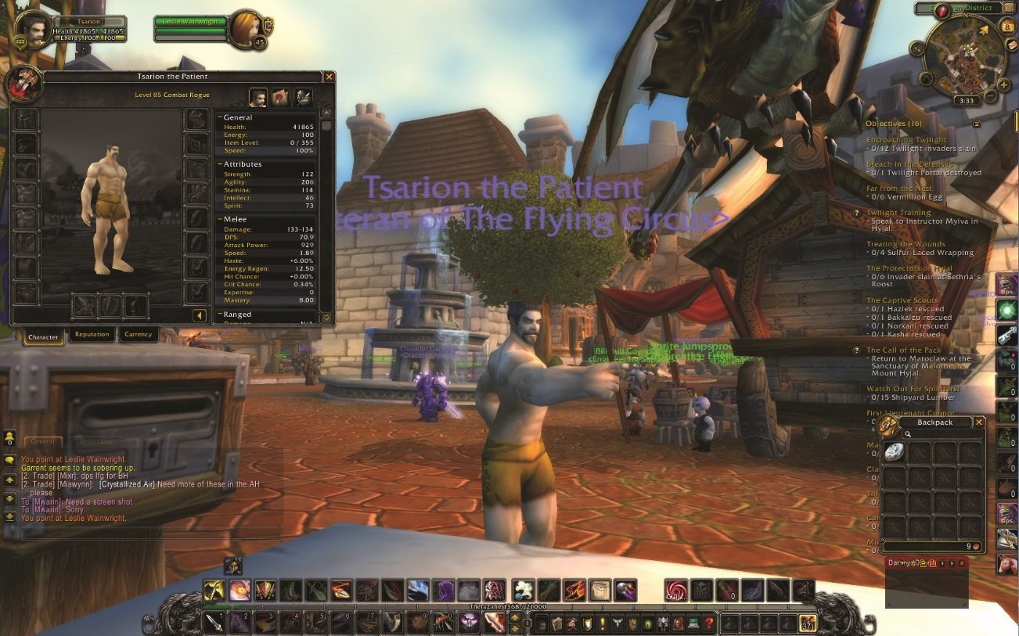
Access Control
Figure 28.9 I’ve been robbed! My fine armor is gone, my bags are empty,
and my bank account only has a few copper pieces!

Slide 31
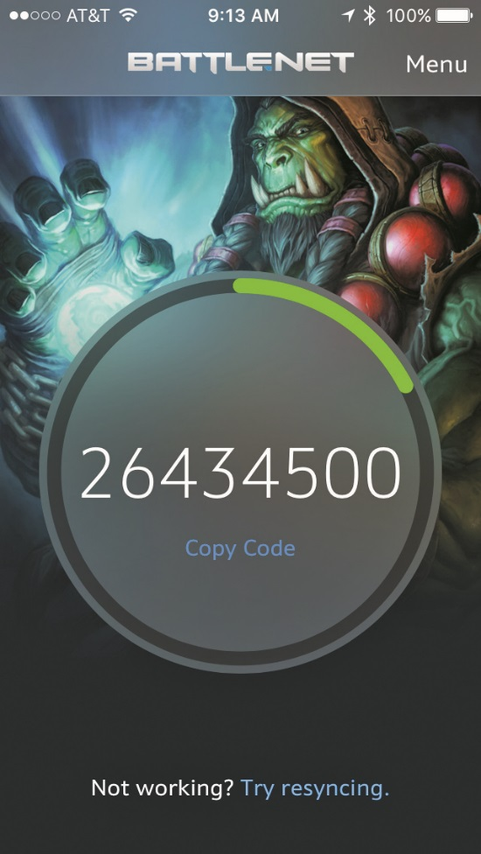
Access Control
Figure 28.10 Blizzard Entertainment software security token for iPhone

Slide 32

Access Control
Figure 28.11 Microsoft keyboard with fingerprint accessibility

Slide 33
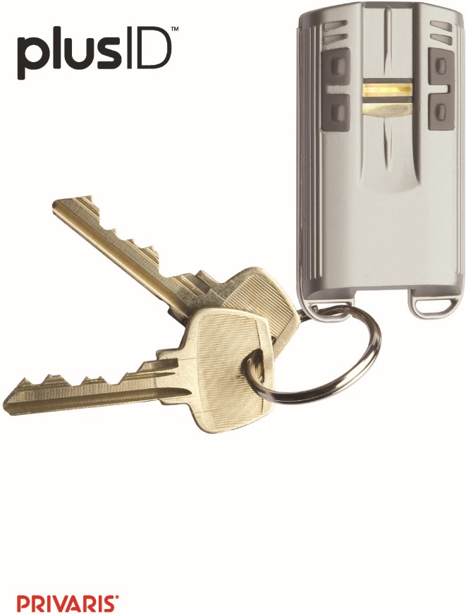
Access Control
Figure 28.12 plusID (photo courtesy of Privaris, Inc.)

Slide 34
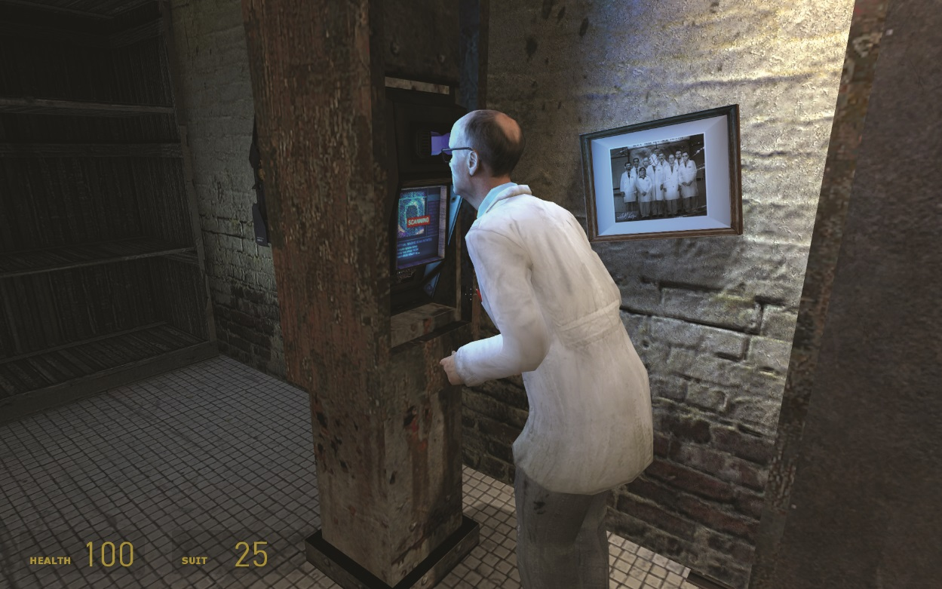
Access Control
Figure 28.13 Retinal scanner in Half-Life 2

Slide 35
Access Control
Users and groups
Using NTFS enables highest level of control.
Apply the principle of least privilege.
Grant permission to access only the resources needed.
Disable unused accounts.
Give permissions to groups, not user accounts.
Take effective permissions into account.
Combined permissions if user is member of more than one group
Watch out for default user accounts and groups.
Lock down Everyone group; disable Guest account.

Slide 36
Access Control
Security policies
Address issues that fall outside the scope of shared resources.
Can the user log on to all systems and at all times?
Can the user install software?
Policies apply to user accounts, computers, or groups.
A Local Security Policy applies to an individual computer.
A domain-based Group Policy applies to all computers in a domain.

Slide 37
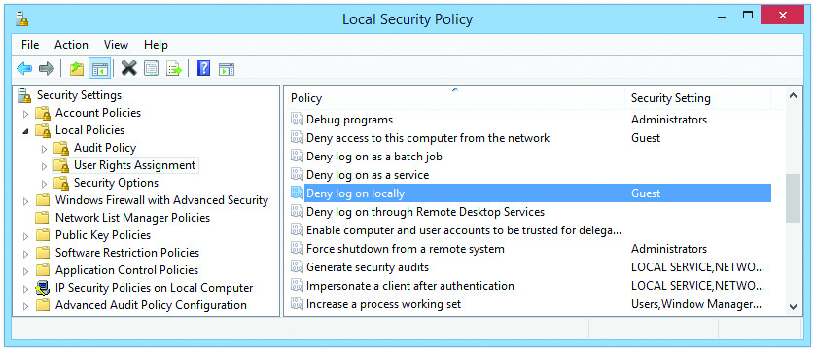
Access Control
Figure 28.14 Local Security Policy

Slide 38
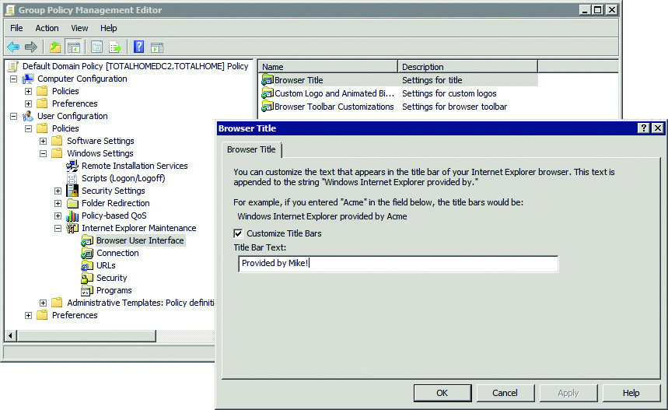
Access Control
Figure 28.15 Using Group Policy to make IE title say “Provided by Mike!”

Slide 39
Access Control
Controlling access with permissions:
Prevent Registry Edits
Prevent Access to the Command Prompt
Prevent unauthorized access, users must log on
Defines who may shut down the system
Forces a minimum password length
Can set account lockout threshold
Disable Windows Installer
Printer Browsing
Enables users to browse for printers on the network, instead of only using assigned printers

Slide 40
Access Control
Once logged on, data access can also be restricted.
Data classification
Organizes data according to sensitivity
Varies by organization
Examples: Confidential, Top Secret
Compliance
Members must comply with rules that apply to the organization.
Laws and company policies apply and should be followed.

Slide 41
Access Control
More data access controls
Commercial licensing
End User License Agreement (EULA) stipulates requirements of the copyright holder.
Digital rights management (DRM) enforces how commercial software is used.
Non-commercial licensing
Software may be free for some or all purposes.

Slide 42
Access Control
More data access controls
Open source software
Permits modifications to the original code
Closed source software
Prohibits modifying the source code or making it part of some other software
Know which licenses are paid for by your company
Ensure company abides by those licenses

Slide 43
Access Control
Reporting security incidents
Event Viewer
Enables you to read the logs created by auditing
Need to set up auditing first
Auditing types
Event auditing and object access auditing
Incident reporting
Provides a record of accomplished work
Provides a piece of information that may reveal pattern or larger problem

Slide 44
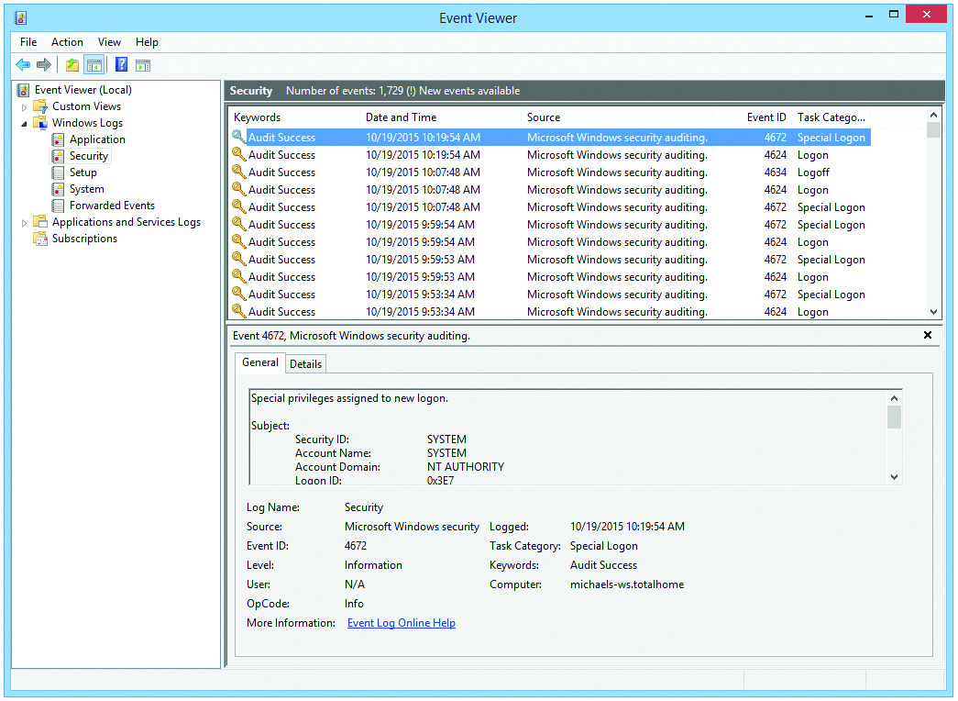
Access Control
Figure 28.16 Event Viewer displaying security alerts

Slide 45
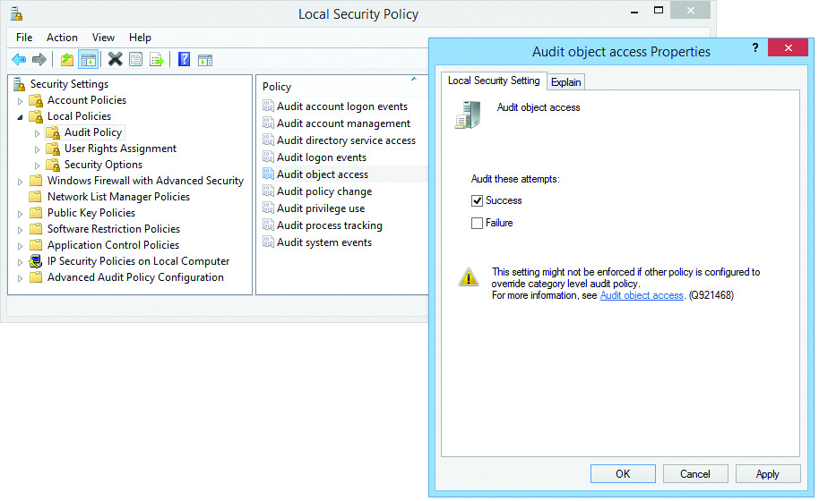
Access Control
Figure 28.17 Audit object access Properties dialog box,
with Local Security Policy open in the background

Slide 46
Access Control
Evidence handling
Ignore personal information in and around a person’s computer.
Identify the action or content as prohibited.
The Acceptable Use Policy (AUP) defines what actions employees may or may not perform on company equipment.
Report through proper channels.
Company may employ a security officer or an incident response leader.

Slide 47
Access Control
Data/device preservation guidelines to establish a chain of custody
Isolate the system.
Document when you took control of the system and what actions you took.
Document the transfer of custody if another person takes control of the system.

Slide 48

Access Control

Slide 49
Threats and Countermeasures
Networks face both internal and external threats.
Important concepts:
Internet-borne attacks
Firewalls
Wireless networking

Slide 50
Threats and Countermeasures
Malicious Software
Malware
Any program or code designed to do something undesirable on a system or network
Virus
Two jobs: replication and activation
Worm
Does not need to attach to other programs to replicate

Slide 51
Threats and Countermeasures
More Malicious Software
Trojan horse
Pretends to do one thing while it is doing something else
Rootkit
Uses low-level operating system functions to hide itself
Spyware
Often sneaks onto systems bundled with legitimate software

Slide 52
Threats and Countermeasures
Even more Malicious Software
Ransomware
Encrypts all the data it can gain access to on a system
Asks for money to decrypt data
Botnet
Network of infected computers (zombies) under the control of a single person or group
Common use: sending spam

Slide 53
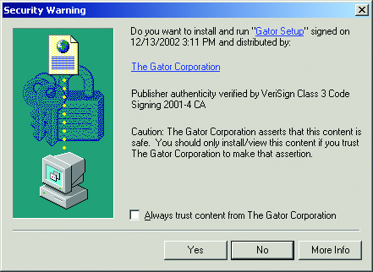
Threats and Countermeasures
Figure 28.18 Gator Corporation’s acknowledgment warning

Slide 54
Threats and Countermeasures
Attack methods and sources
Attack vector
Route taken by malware to infect the system
Zero-day attack
Attack on a vulnerability not already known to the software developers
Spoofing
Process of pretending to be someone or something you are not
Packets containing false information

Slide 55
Threats and Countermeasures
More attack methods and sources
Man-in-the-middle (MITM) attack
Tap into communication between two systems
Reads or changes the data and sends on
Session hijacking
Attempt to intercept a valid computer session to get authentication information
Brute force
Guess the contents of some kind of data field that isn’t obvious (or is hidden)
Example: dictionary attack

Slide 56
Threats and Countermeasures
Even more attack methods and sources
Pop-ups
Pop-ups are surprise browser windows.
Some are deliberately designed to mimic legitimate pop-up alerts from the OS.
Most Web browsers have features to prevent pop-up ads.
Drive-by downloads
Clicking on a pop-up ad starts a file download.
Do not click.
Install spyware detection and removal software.

Slide 57
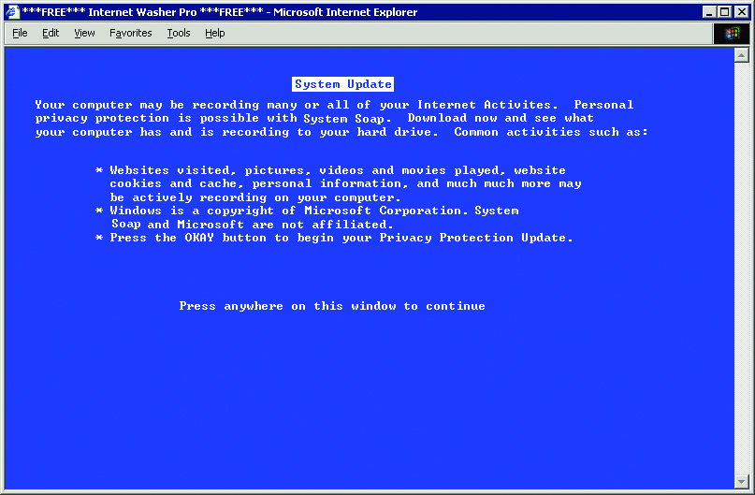
Threats and Countermeasures
Figure 28.19 A spyware pop-up browser window, disguised as a Windows alert

Slide 58
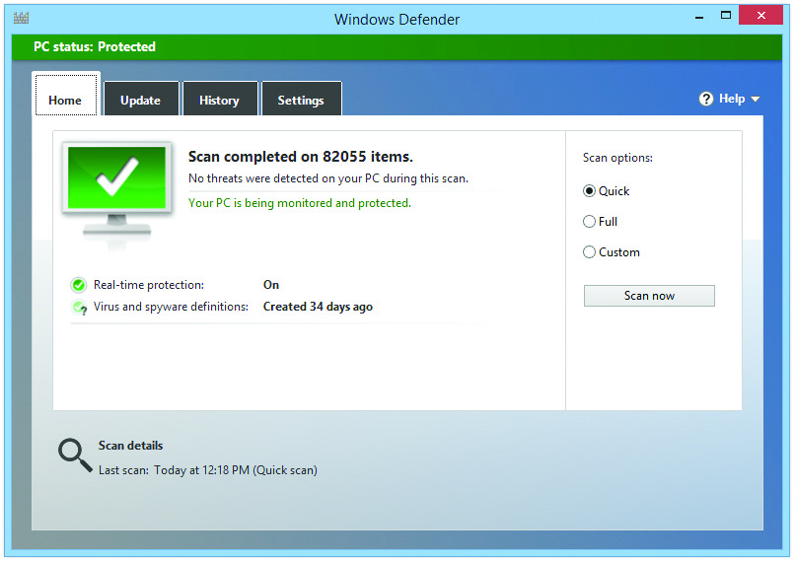
Threats and Countermeasures
Figure 28.20 Windows Defender

Slide 59
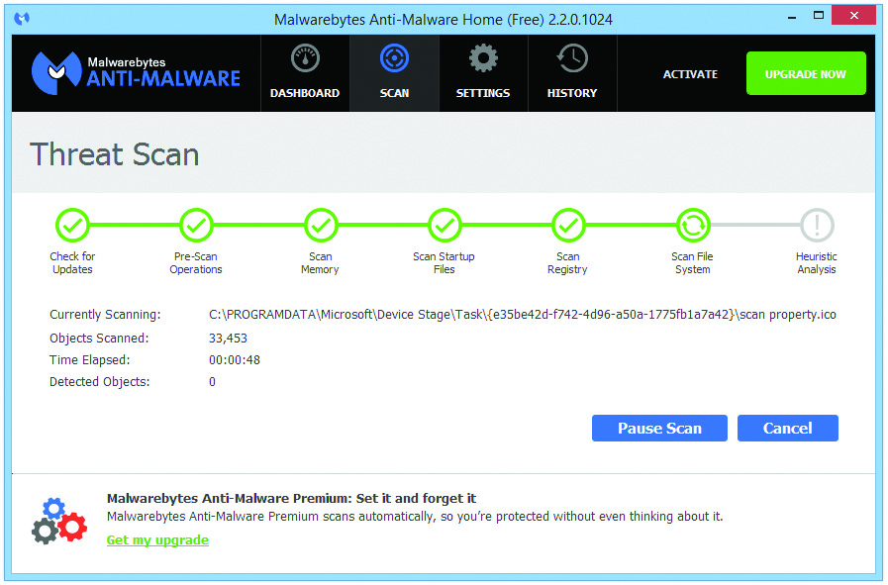
Threats and Countermeasures
Figure 28.21 Malwarebytes

Slide 60
Threats and Countermeasures
Spam is also an attack
Unsolicited e-mail
Often used for phishing scams
Defenses against spam
Never post your email address on the Internet.
Use filtering software.
Never click on any link or open email from someone you do not know.

Slide 61

Threats and Countermeasures

Slide 62
Detection, Prevention, and Recovery
Symptoms can appear to be normal PC malfunctions.
Momentary slowdowns, or random crashes happening more frequently than usual
Sometime malware attempts to rename system files, change file permissions, or hide files completely.
Regular anti-malware scan will usually catch issues.

Slide 63
Detection, Prevention, and Recovery
Other malware symptoms
Preventing Windows Update and other programs from working
Stopping anti-malware programs from updating and working
Changing permissions on files
Denying access to files or programs
Preventing Internet connectivity
Overwriting HOSTS file to redirect DNS queries and Web surfing

Slide 64
Detection, Prevention, and Recovery
A rogue anti-malware program is malware disguised as an anti-malware program.
Stick to the recommended lists of anti-malware software found online.
Watch for security alerts in Windows or from your third-party anti-malware program.

Slide 65
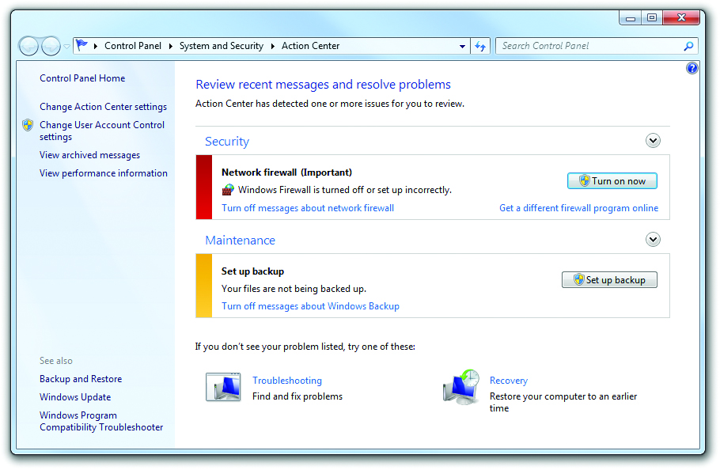
Detection, Prevention, and Recovery
Figure 28.22 Windows 7 Action Center

Slide 66
Detection, Prevention, and Recovery
Actions to prevent and recover
Use specialized anti-malware programs.
Know how to stop the spread of malware.
Know how to fix infected computers.
Know how to restore systems when possible.
Dealing with malware
Anti-malware programs
Training and awareness
Patch/update management
Remediation

Slide 67
Detection, Prevention, and Recovery
Anti-malware program (such as a classic antivirus program)
Scans files
Passively monitors computer’s activity
Operates as virus shield
Detects boot sector viruses by comparing the drive’s boot sector to a standard boot sector
Uses a library of signatures to detect executable viruses
A signature is a code pattern of a known virus.
Notes:
Note: The term antivirus (and antispyware, or anti-anything) is becoming obsolete. Viruses are only a small component of the many types of malware. Many people continue to use the term as a synonym for anti-malware.

Slide 68
Detection, Prevention, and Recovery
Polymorph virus
Attempts to change signature to prevent detection
Typically continually scrambles useless code
Techniques to combat polymorphs
Scrambling code becomes the signature, so becomes detectable by anti-malware programs.
A checksum is created on every file in the drive.
Every time a program is run, anti-malware program calculates a new checksum and compares it with the previous one. If different, a virus is likely present.

Slide 69
Detection, Prevention, and Recovery
Stealth virus programs
Boot sector viruses that use various methods to hide from anti-malware programs
User education
Teach caution when dealing with incoming email a user does not recognize.
Explain the dangers of questionable Web sites.
Teach users how to react when they see questionable actions taking place.

Slide 70
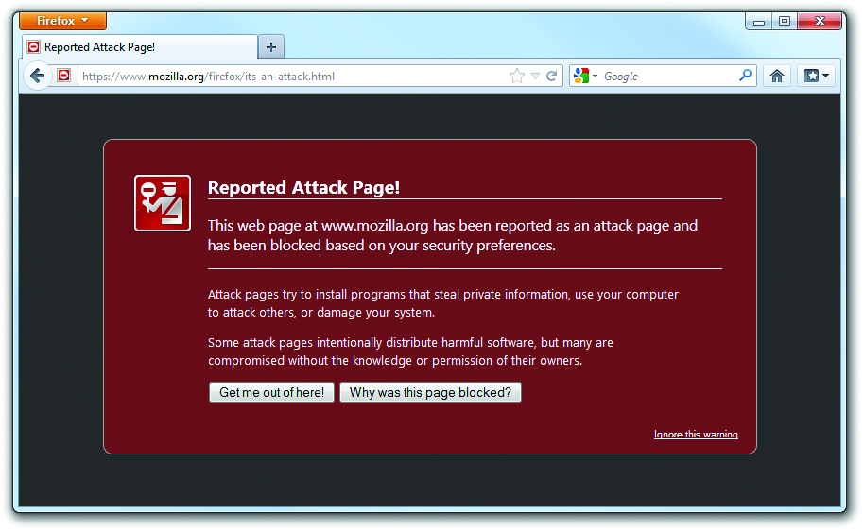
Detection, Prevention, and Recovery
Figure 28.23 Attack site warning

Slide 71
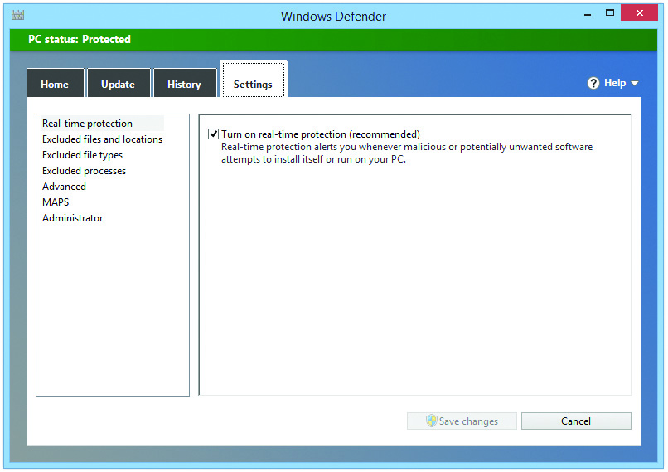
Detection, Prevention, and Recovery
Figure 28.24 A virus shield in action

Slide 72
Detection, Prevention, and Recovery
Malware prevention tips
Use an anti-malware program with a virus shield that automatically scans e-mail, downloads, and running programs.
Scan PCs daily and keep anti-malware program updated.
Keep that definition file up to date so your antivirus software has the latest signatures.
Know the source of any software before loading.
Notes:
72
One of the most important malware mitigation procedures is to keep systems under your control patched and up to date through proper patch management. Microsoft, Apple, and the Linux maintainers do a very good job of putting out bug fixes and patches as soon as problems occur. If your systems aren’t set up to update automatically, then perform manual updates regularly.

Slide 73
Detection, Prevention, and Recovery
Boot media Anti-Malware tools
Many anti-malware companies provide bootable CDs or USB flash drives.
Enable booting from a known-clean OS.
Run the same anti-malware software, uncorrupted by malware on your system.

Slide 74
Detection, Prevention, and Recovery
Best practice procedure for malware removal
Identify malware symptoms.
Quarantine infected system. (remove from network and unnecessary peripherals)
Disable system restore (in Windows).
Remediate infected systems.
Update anti-malware software.
Use scan and removal techniques (Windows Safe Mode or Preinstallation Environment).
Schedule scans and run updates.
Enable system restore and create a restore point.
Educate end user.

Slide 75
Detection, Prevention, and Recovery
Additional Malware recovery tips
Recognize and quarantine
PacketFence automatically monitors network traffic and cuts off a computer if it starts sending suspicious packets.
Quarantine a computer by manually disconnecting the network cable.
Disable system restore so the virus is not included in any restore points.

Slide 76
Detection, Prevention, and Recovery
More Malware recovery tips
Search and destroy
Get to a safe boot environment and run anti-malware software.
Windows Safe Mode
Windows Recovery Environment
Bootable CD or flash drive
Some anti-malware software comes in a bootable version.
Live disk option for Ubuntu Linux allows booting to the disk.
Download and burn a copy of the Ultimate boot CD.

Slide 77
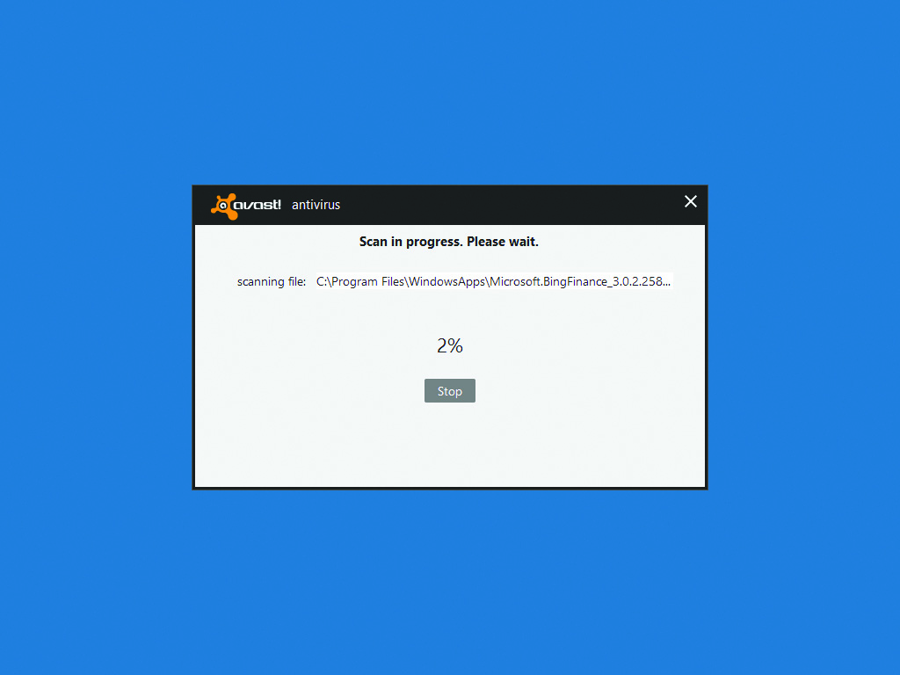
Detection, Prevention, and Recovery
Figure 28.25 avast! Virus Cleaner Tool

Slide 78
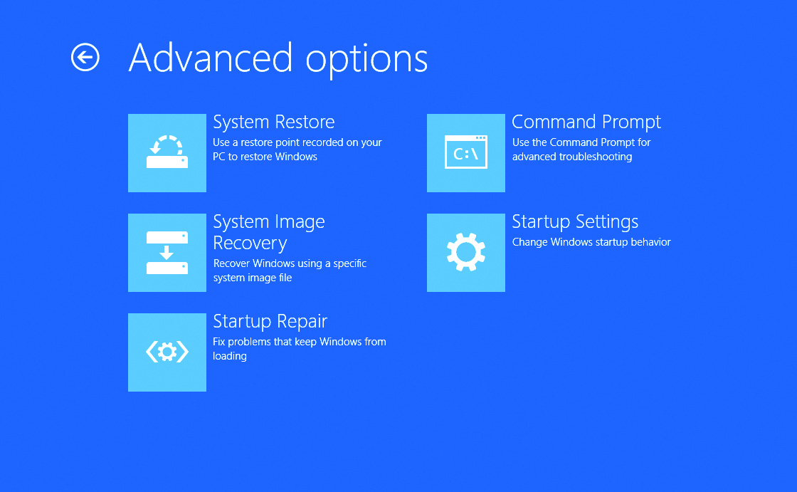
Detection, Prevention, and Recovery
Figure 28.26 System Recovery Options in Windows Vista

Slide 79
Detection, Prevention, and Recovery
Remediation
Fix files damaged by malware.
Replace corrupted Windows registry files or startup files.
Use Windows Recovery Environment/System Recovery Options if Windows will not start.
Re-enable System Restore once the system has been repaired.

Slide 80
Detection, Prevention, and Recovery
Educate
Talk with users.
Show samples of dangerous e-mails.
Have users run anti-malware programs regularly.

Slide 81
Detection, Prevention, and Recovery
Firewalls protect an internal network from unauthorized access to and from the Internet.
Hardware firewalls are often built into routers.
Filters packets before they reach internal machines.
Software firewalls run on computers.

Slide 82
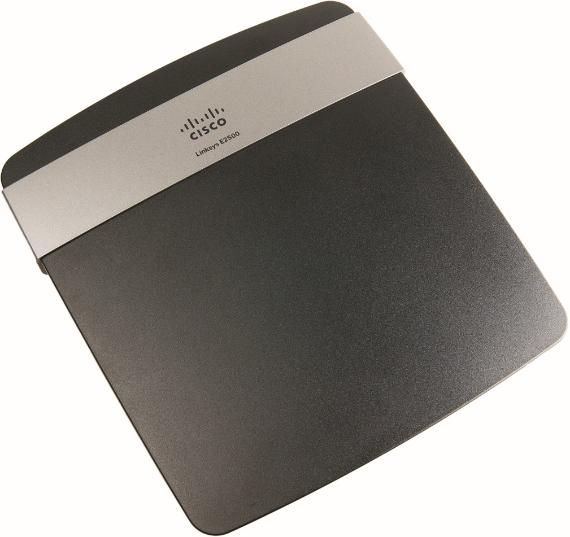
Detection, Prevention, and Recovery
Figure 28.27 Linksys router as a firewall

Slide 83
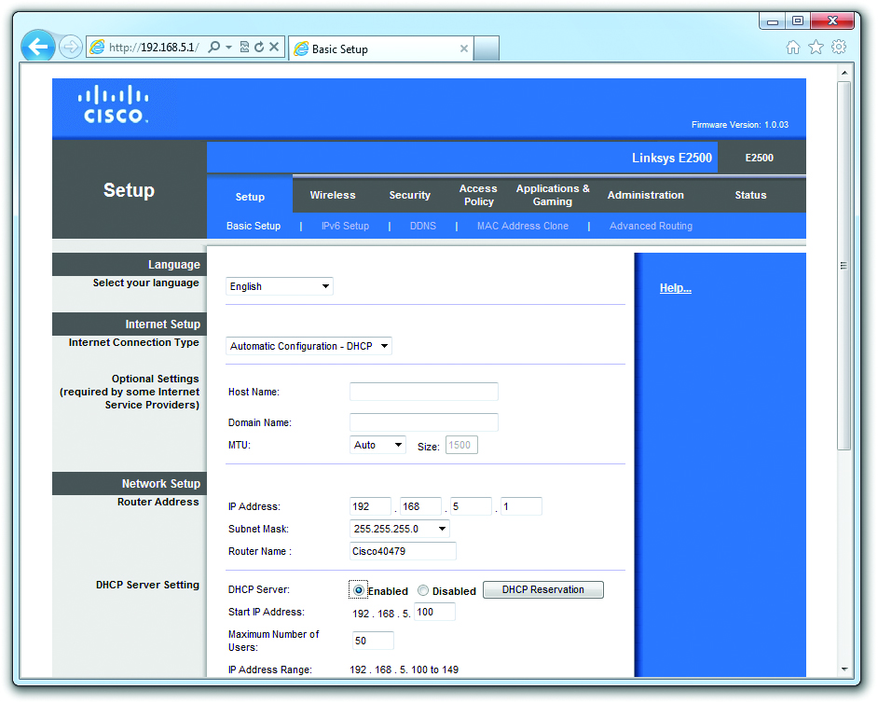
Detection, Prevention, and Recovery
Figure 28.28 Default Web interface

Slide 84
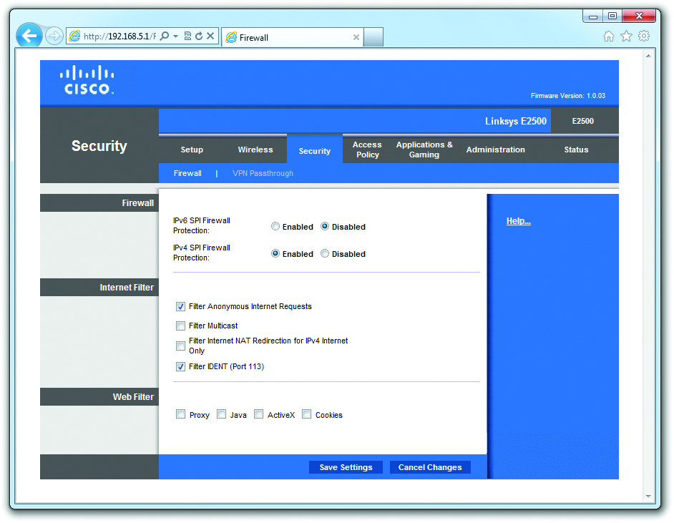
Detection, Prevention, and Recovery
Figure 28.29 SPI firewall settings

Slide 85
Detection, Prevention, and Recovery
Configuring a hardware firewall
Hardware firewalls use Stateful Packet Inspection (SPI) to inspect each incoming packet individually.
Blocks any incoming traffic that isn’t in response to your outgoing traffic
Disable ports entirely to block all traffic in or out.
Port forwarding allows outside users access to a Web server on the LAN.
Open a port in the firewall and direct incoming traffic on that port to a specific IP address.

Slide 86
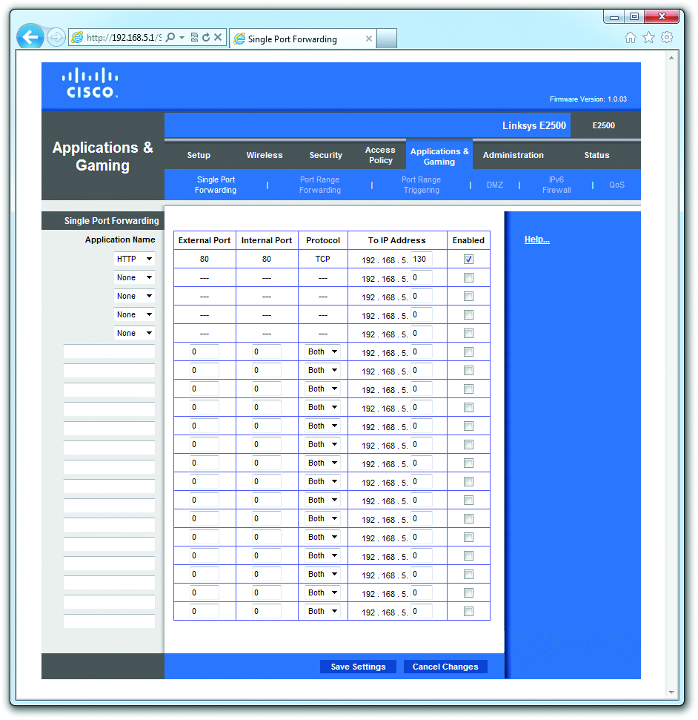
Detection, Prevention, and Recovery
Figure 28.30 Firewall Port forwarding

Slide 87
Detection, Prevention, and Recovery
Firewall Port triggering opens an incoming connection to one computer automatically based on a specific outgoing connection.
Trigger port defines the outgoing connection.
Destination port defines the incoming connection.
A demilitarized zone (DMZ) puts systems with the specified IP addresses outside the protection of the firewall.
Opens all ports and enables all incoming traffic—a dangerous situation!

Slide 88
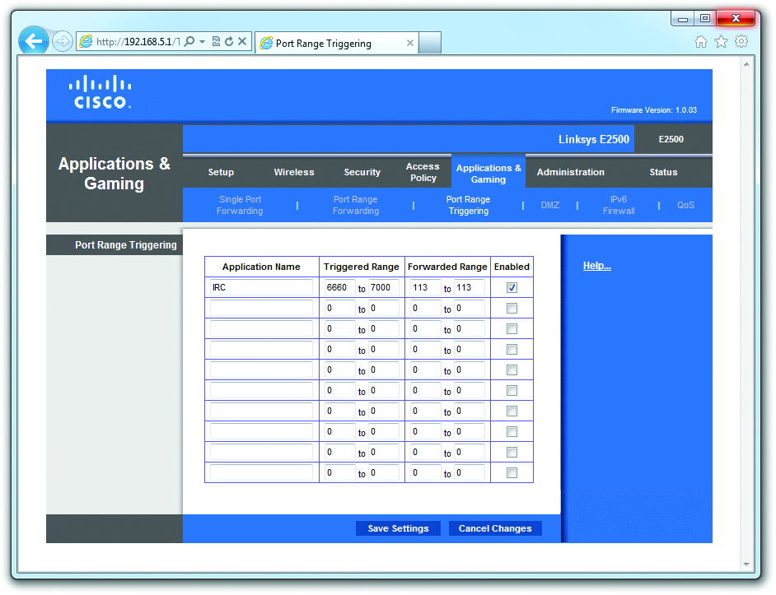
Detection, Prevention, and Recovery
Figure 28.31 Firewall Port triggering

Slide 89
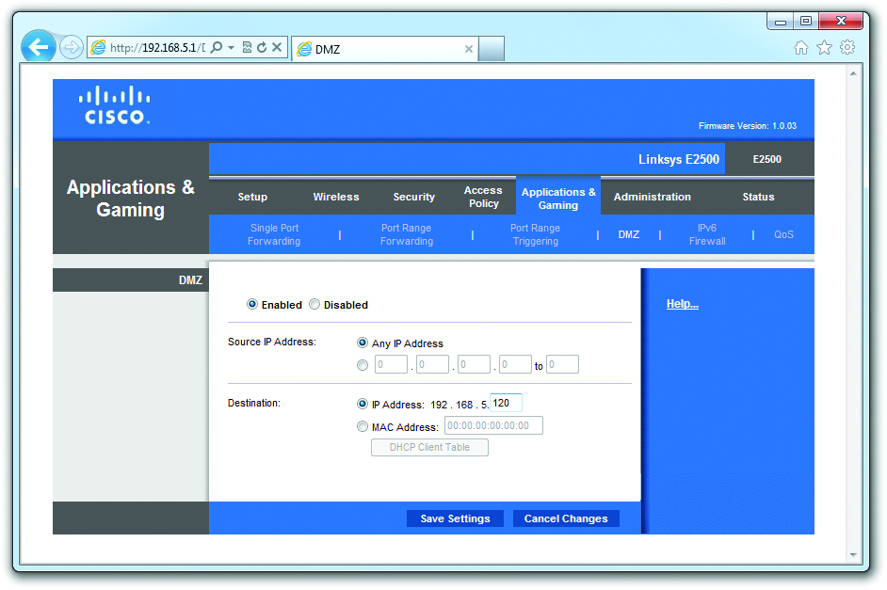
Detection, Prevention, and Recovery
Figure 28.32 DMZ set up on a SOHO router firewall

Slide 90
Detection, Prevention, and Recovery
Software firewalls
Windows Firewall or Windows Firewall with Advanced Security are built into each version of Windows.
Access Windows Firewall by opening the Windows Firewall applet in the Control Panel
Configure Windows Firewall by:
Turning it on or off
Choosing which programs and services can pass through the firewall (exceptions)

Slide 91
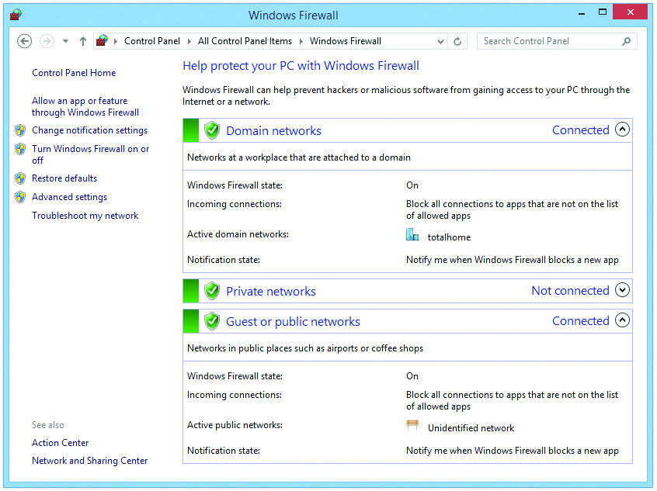
Detection, Prevention, and Recovery
Figure 28.33 Windows 7 Firewall applet

Slide 92
Detection, Prevention, and Recovery
Three network types in Windows Vista/7 are:
Domain, Private, and Guest or Public
You are prompted to choose the network type the first time you connect.
When you select Home, Work, or Public location, Windows configures Windows Firewall to block or unblock discovery and sharing services.
When running on a private (Home or Work) network, Windows enables Network Discovery and File and Printer Sharing as exceptions.
Disables on Guest or Public network

Slide 93
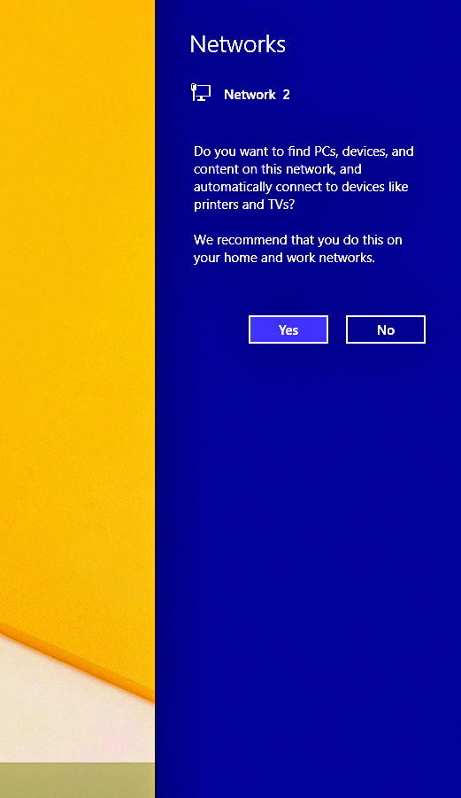
Detection, Prevention, and Recovery
Figure 28.34 Set Network Location in Windows 8.1

Slide 94
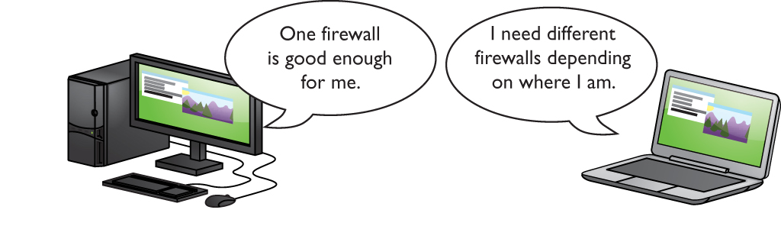
Detection, Prevention, and Recovery
Figure 28.35 Many machines need more than one network setting.
Think “Security in Layers”.

Slide 95
Detection, Prevention, and Recovery
Windows Firewall with Advanced Security
Gives more control over exceptions
Expands exceptions to include outbound and inbound data separately

Slide 96
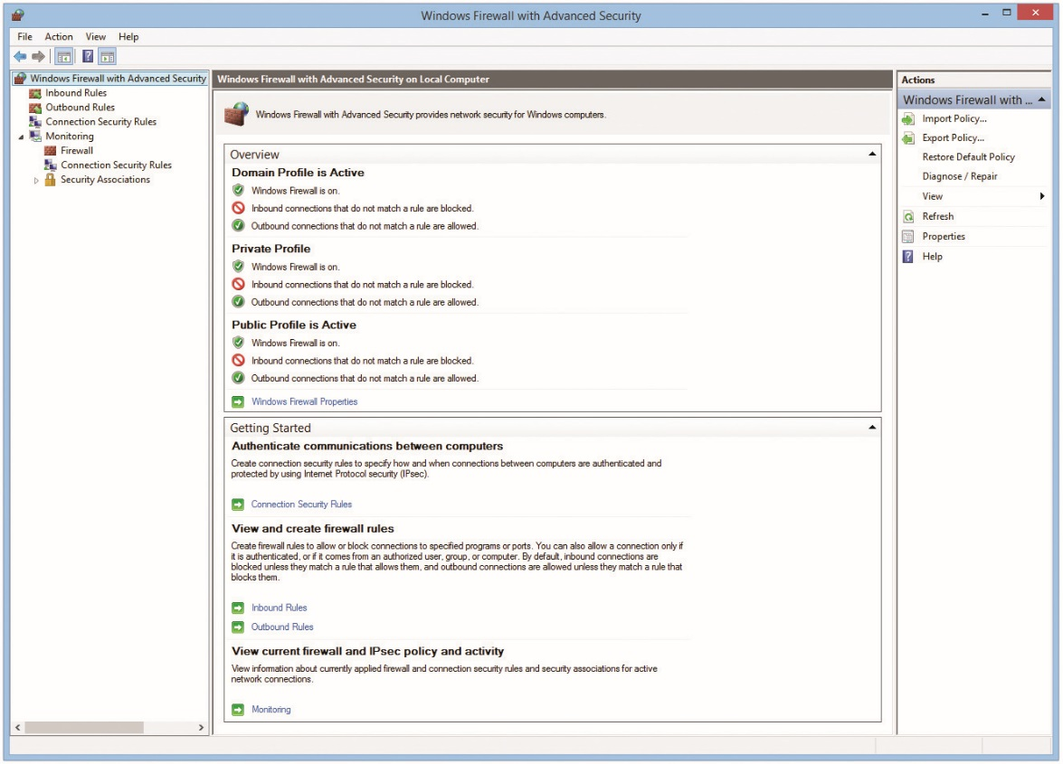
Detection, Prevention, and Recovery
Figure 28.36 Windows Firewall with Advanced Security

Slide 97
Detection, Prevention, and Recovery
A rule always includes:
The name of program
Group: an organizational group that helps sort all the rules
The associated profile (All, Domain, Public, Private)
Enabled/disabled status
Remote and local address
Remote and local port number

Slide 98
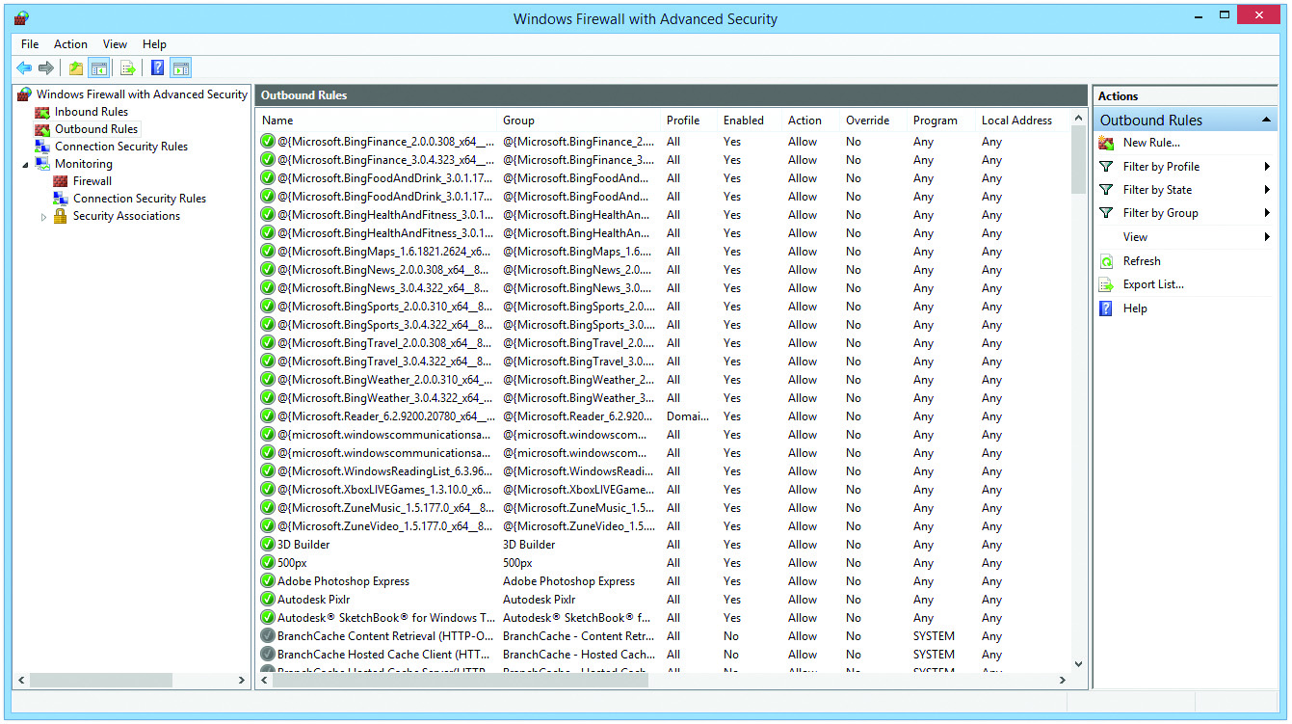
Detection, Prevention, and Recovery
Figure 28.37 Firewall Outbound Rules list

Slide 99
Detection, Prevention, and Recovery
Internet Appliances
Intrusion Detection System (IDS)
Inspects packets, looking for active intrusions
Exceeds firewall functionality because it inspects traffic inside the network
Logs or notifies when attacks occur
Intrusion Prevention System (IPS)
Provides active monitoring
Stops an attack while it is happening
Blocks incoming packets or fixes packets on-the-fly

Slide 100
Detection, Prevention, and Recovery
More about internet appliances
Unified threat management (UTM)
Packages traditional firewall with other security services
IPS
VPN
Load balancing
Antivirus
Builds robust security into the network

Slide 101
Detection, Prevention, and Recovery
Authentication and Encryption
Firewalls cannot stop interceptor hackers who monitor traffic on the Internet looking for vulnerabilities.
Turn to encryption to make packets unreadable.
In a local network, authentication and encryption are usually handled by the OS.
Standard encryption methods such as MIT’s Kerberos works well, even in mixed networks.
Notes:
101

Slide 102
Detection, Prevention, and Recovery
Data encryption
Numerous ways to encrypt network data
Microsoft’s encryption method of choice is IPSec (derived from IP security).
Application encryption
Secure Sockets Layer (SSL)
Transport Layer Security (TSL)
HTTPS (HTTP over TLS)
Notes:
102

Slide 103
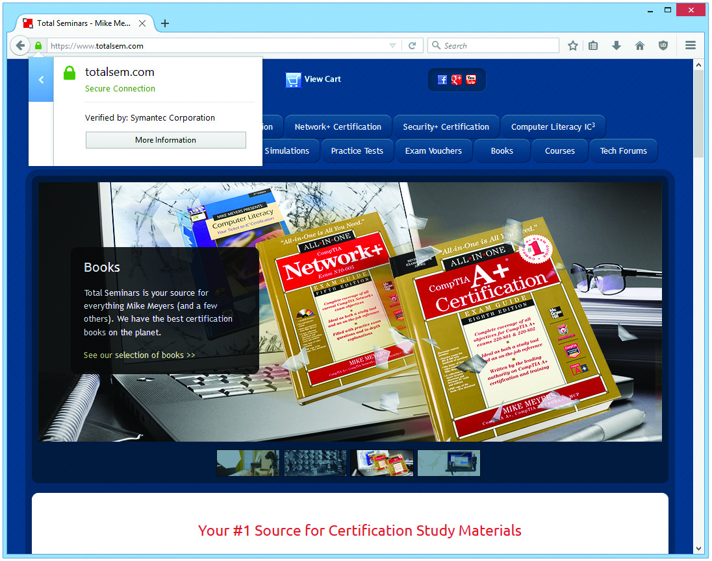
Detection, Prevention, and Recovery
Figure 28.38 A secure Web site

Slide 104
Detection, Prevention, and Recovery
Both the Web server and your browser must encrypt and decrypt each other’s data to make a secure connection.
Public keys are sent in the form of a digital certificate.
This certificate is signed by a trusted certificate authority (CA).
Your Web browser has a built-in list of trusted authorities, referred to as a trusted root CA.
If your browser sees a suspicious certificate, you are warned and asked if you wish to accept it.
Notes:
104

Slide 105
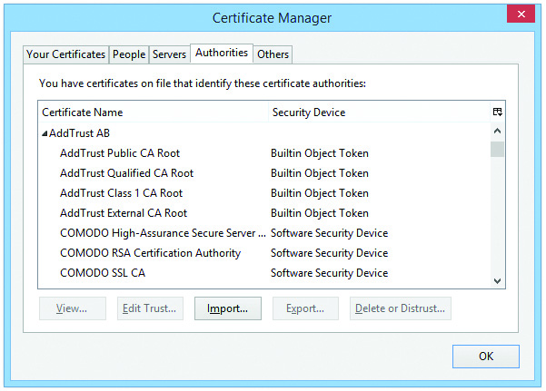
Detection, Prevention, and Recovery
Figure 28.39 Trusted authorities

Slide 106
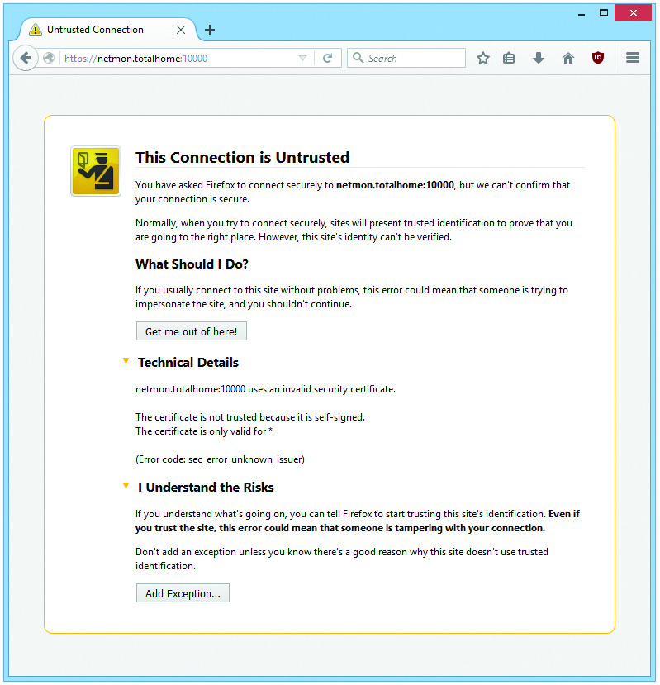
Detection, Prevention, and Recovery
Figure 28.40 Incoming certificate

Slide 107
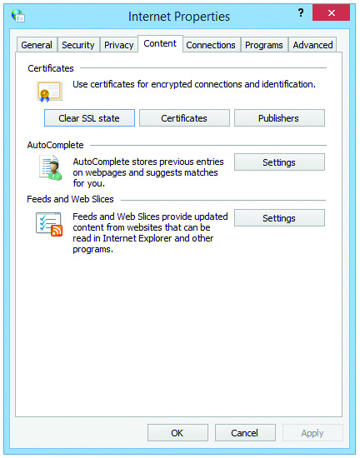
Detection, Prevention, and Recovery
Figure 28.41 Internet Options Content tab in Internet Explorer

Slide 108
Detection, Prevention, and Recovery
Wireless Issues (Layer security)
Set up wireless encryption (WPA/WPA2).
Disable DHCP and use static IP addresses.
If DHCP is needed, limit the number of addresses.
Change WAP’s SSID from the default.
Filter by MAC address.
Change default user name and password.
Update firmware as needed.
Enable the WAP’s firewall settings.

Slide 109
Detection, Prevention, and Recovery
Most wireless security considerations
Configure SOHO router NAT/DNAT settings
Use SOHO router content filtering/parental controls.
Consider physical security of SOHO router.

Slide 110

Detection, Prevention, and Recovery

Slide 111
Summary
Analyzing Threats
Access Control
Threats and Countermeasures
Detection, Prevention, and Recovery
Notes:
111
Instructor Tip
When gaining attention and establishing common ground, ask questions of the class such as, “How many of you have ever had a computer infected by a virus or spyware?” or “How many of you have ever lost data?”
For a WIIFM statement, say to the class, “Joe’s at work, and Sally calls him up on the phone saying she’s from the IT department and needs to upgrade his computer with several key applications. Joe’s computer will be down for several hours. “Oh no,” he says, realizing he needs to get some work done and needs the computer. “Isn’t there another way?” Joe asks. Sally says, ‘Well, don’t tell anyone I’m doing this, but I can do it remotely while you’re still using the computer. The thing is, though, I’ll need your user name and password.” Does Joe give the password to Sally? This is a classic example of social engineering; Sally doesn’t really work in the IT department but instead is simply randomly calling people trying to get their password. We’ll learn about this and other security threats in this chapter.”

Slide 112


